Slide 1
Calculation Procedures
A calculation procedure is a series of calculations performed on matrix lookups and user-defined variables and constants. A calculation matrix is a table that looks up information using multiple input dimensions and returns the corresponding output value. Calculation procedures are part of pricing rules.

Slide 2
Vlocity Calculations Overview
Vlocity Calculations automate the creation of complex quotes. Calculation Matrices enable you to create multidimensional lookup matrices. Vlocity calculation procedures provide tools to configure matrix lookups, set variables and constants, and to perform basic math operations. Vlocity Calculations can guide a customer or agent through a series of questions, pull data from various sources, and present one or more customized quotes or eligibility determinations
Vlocity Calculations accept input from a Salesforce form, REST API, and OmniScript (in the data JSON). Inputs can come from more than one source. Vlocity Calculations executes a Vlocity Calculations Procedure and returns the result as a proposal or PDF, or as data for populating an OmniScript, form, list, JSON structure, or for calling a REST API.

Slide 3
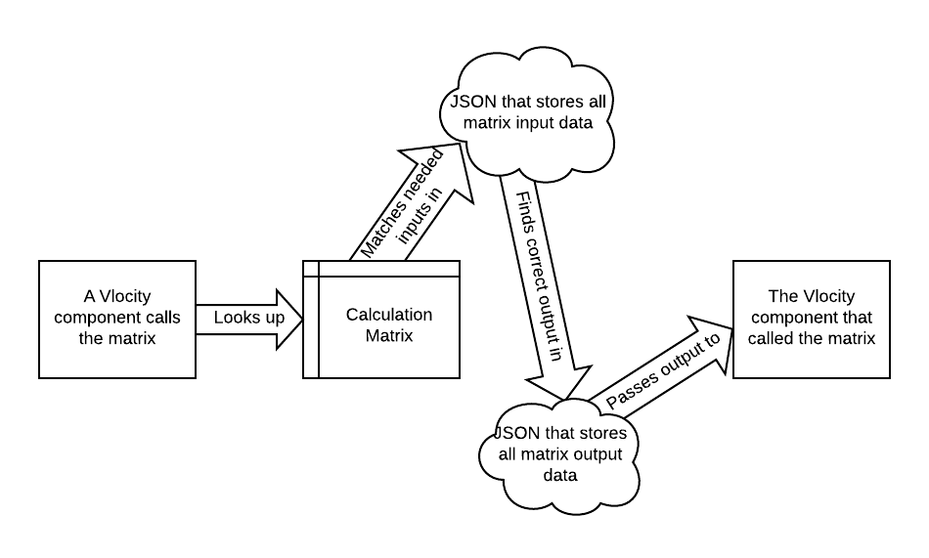
Calculation Matrices
Calculation matrices are one of the key elements of a Vlocity rating engine. Vlocity uses calculation matrices to look up inputs, match them to outputs, and provide the outputs to calculation procedures.
Vlocity offers three styles of calculation matrices you can use based on your business needs:
Standard Calculation Matrix
Grouped Calculation Matrices
Row-Versioned Calculation Matrices
Note
You can't create calculation matrices that are both grouped and row-versioned.

Slide 4
How Calculation Matrices Work in Context
A calculation matrix is a Vlocity rating table that is structured and stored as follows:
One input column or a set of input columns
Input column header names must match inputs, such as attributes and remote options
Each input or set of inputs must be unique
Vlocity stores all input column header names and all input data in one JSON
One output column or a set of output columns
Outputs and sets of outputs don't need to be unique
Vlocity stores all output column header names and all output data in one JSON

Slide 5
You can have multiple versions of the same calculation matrix enabled at the same time. Vlocity uses the start date/time, end date/time, and priority (highest number is highest priority, so 2 is higher priority than 1) to determine which version of the matrix to use.
If the start date/time of one version of a calculation matrix overlaps the end date/time of another calculation matrix, you can set priorities on them to enable Vlocity to determine which one to use. If a call to a calculation matrix specifies an effective date, Vlocity uses that date to find the correct matrix. If a date isn't specified, Vlocity uses today as the effective date.
The call to the calculation matrix finds the right hash, matches the input, unpacks the output JSON, finds the correct output, and returns it.

Slide 6
Wildcards
Starting in Winter '20, you can make it possible for calculation procedures and other Vlocity features that call calculation matrices to use a wildcard in place of a value for one column.
You set up your wildcard column when you first create your calculation matrix. So you need to know the exact name of the column and the value of the wildcard.
For the State example, the column name and value can be:
Wildcard Column: state
Wildcard Value: ALL
Wildcard columns work in standard, grouped, and row-versioned calculation matrices.

Slide 7
Calculation Procedures Overview
A Calculation Procedure is a series of calculations performed using matrix lookups and user-defined variables and constants. A calculation procedure can call Apex classes for pre- and post-calculation custom logic. Calculation procedures are part of pricing rules.
There are two types of calculation procedures:
Class-based: Pricing logic is written in an Apex class.
Declarative: Pricing logic is implemented using matrix lookups, variables, constants, and basic math operations.
Declarative calculation procedures are associated with DataRaptor mappings. Declarative calculation procedures use DataRaptors to read and save data from Salesforce objects. You can add variables from the DataRaptor extract, such as Original Price (Currency) and Quantity (Number). For example, you can add a currency variable named UnitPrice as a calculation output that can be used in a DataRaptor load to update a field in a Salesforce object.

Slide 8
Calculation Procedures Overview
A calculation procedure can use two types of steps.
Matrix: If you have enabled Calculation Matrices, a calculation procedure can include a Calculation Matrix in the calculation steps.
Formula: For example, you can specify the UnitPrice variable as output. If you are using DataRaptor mappings, the calculation procedure output variable name must match the DataRaptor Load input variable name
Each step in a Calculation Procedure can have a condition that must be met in order for the step to be executed.
In the Preprocessor Class Name section of the calculation procedure, you must specify the class that implements a nameSpace.VlocityOpenInterface calculation method.
To include the output from a calculation step in the final output, select Include in output.

Slide 9
Functions for Calculation Procedures
For aggregation steps, the following functions are supported.
Function | Description | Example
AVG | Average of list of values. | AVG(1,2,3,4,5,6,7,8,9,10) returns 5.5
MAX | Maximum value in a list of values. | MAX(1,2,3,4,5,6,7,8,9,10) returns 10
MIN | Minimum value in a list of values. | MIN(1,2,3,4,5,6,7,8,9,10) returns 1
SUM | Returns the sum of a list of values | SUM(1,2,3,4,5,6,7,8,9,10) returns 55
For looping procedures: PREVIOUS

Slide 10
What's in a Calculation Procedure
A well-formed calculation procedure contains the following elements:
Constants
All the constants you need for each calculation step
Variables
Input variables, all the variables you need for each calculation step and the group key and subgroup key if you're calling a group of matrices all the variables in calculation matrices you call in matrix lookup steps
Calculation steps, including:
Calculations
Each calculation required to get to the correct result of the whole calculation procedure
Matrix lookups
Finds one or more variable values in calculation matrices, based on one or more variable inputs
Aggregation steps (optional)
If this calculation procedure will handle an array of inputs, aggregation steps will perform calculations over the output sets.

